Slide 1
Data x: integrull

Slide 2
the team
Jake Mainwaring
Chase Smith
Lawrence Yan
Cyril Tamraz

Slide 3
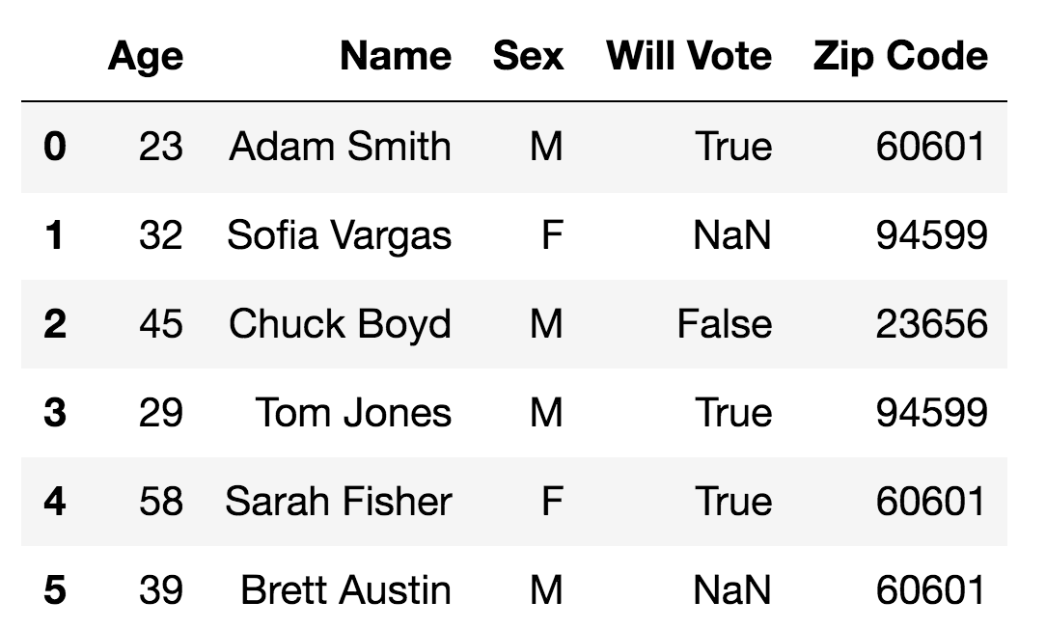
High level description
Current problem – many datasets have columns with missing values. Although there are workarounds (excluding rows with empties, replacing with column means), these methods often result in information loss and can be tedious for data scientists.
Our solution – create a tool that fills missing values in a more intelligent way. Each column is treated as a separate prediction problem, using the completed rows as training data.

Slide 4
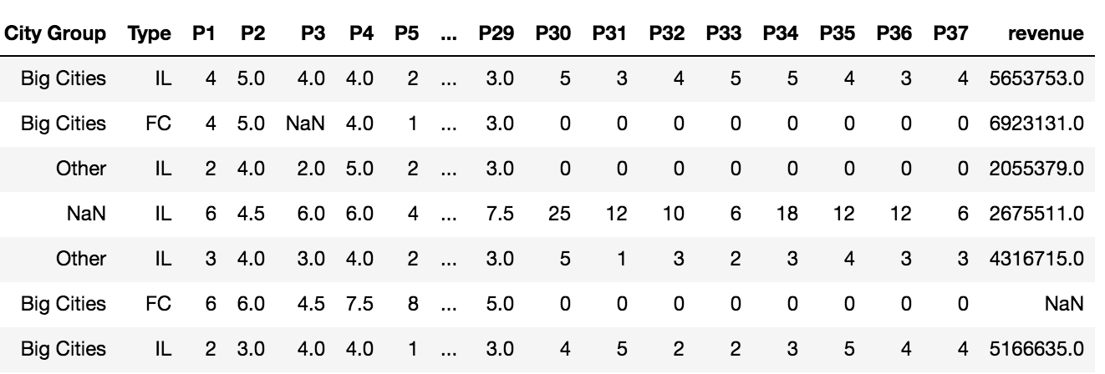
HOW IT WORKS
A
B
Identify the columns with null values, and have the user select if it’s a classification or regression problem. Many classification tasks also require mapping the string to numerical values
In each column, split the rows into rows where that value is empty and rows where it’s not. For the rows where it’s not, your training data becomes the array of complete values (response variable) and values from every other column (features)
Train a random forest classifier for each classification task and a ridge regression model for each regression task
Update nulls with each column model’s output. This is added into a new data frame so as to not train the model on previous predictions
Return numeric values back to their respective strings and display updated data frame

Slide 5
why manual selection for variable type?
Initially, we hoped to automatically label each column as a classification or regression problem. We experimented with different rule-based approaches – if the column has string variables, follows a certain distribution, etc. – but eventually decided against this. Imagine two columns, one with 1-5 Likert scale data and another with 5 regions encoded 1-5. These could be almost identical numerically. However, the Likert answer have an inherent low-to-high between them and could be approached with a regression problem, while the 5-region question should not be.
Therefore, we ended up adding a parameter where users choose ‘classification’ or ‘regression’ for each column. Our assumption is that if a user needs to clean data, often for a machine learning model, he or she is presumably familiar with this distinction.

Slide 6
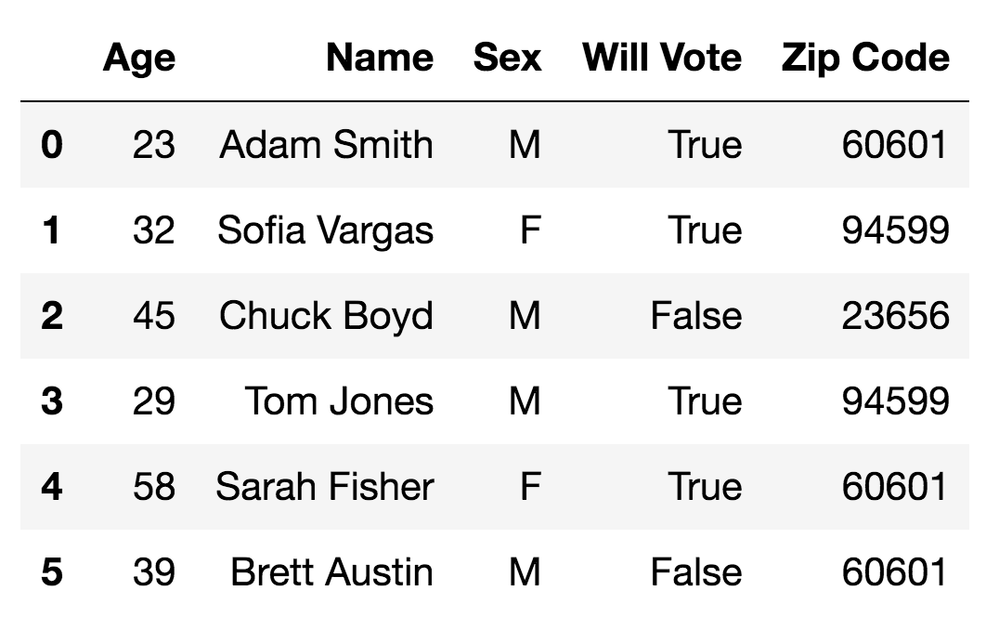
User perspective
Our product is a python library that users can interact with (on top of pandas) to clean datasets

Slide 7
Technical components
Phase 1
Realize our initial project idea was wrong and pivot significantly
Experiment with various classification and regression models on actual datasets
Develop prototype that runs start-to-finish on input data (in python, with pandas and NumPy)
Test prototype on actual datasets to work out kinks
Turn prototype into fully-functional python library
Phase 2
Phase 3

Slide 8
How we could push this further
1
Expand functionality to SQL, R, and other languages commonly used for data analysis
2
Develop UI so analysts without coding experience can still use the product
3
Include an option for automatic detection of regression/classification
4
Improve performance and data storage limitations so our tool can be applied to larger data sets

Slide 9
Project journey
1
Fuzzy matching
2
Column type detection
3
Current state
“Guns N’ Roses”
“Guns And Roses”
“Guns ’N Rosez”
Artist ID | Artist
7164 | Guns N’ Roses
Regression
Classification

Slide 10
GITHUB LINK
https://github.com/jmainwaring/DataX/tree/b48f8b9967e3471af64285ddd967907a42ebdac1

Slide 11
THANK YOU!

